Slide 1
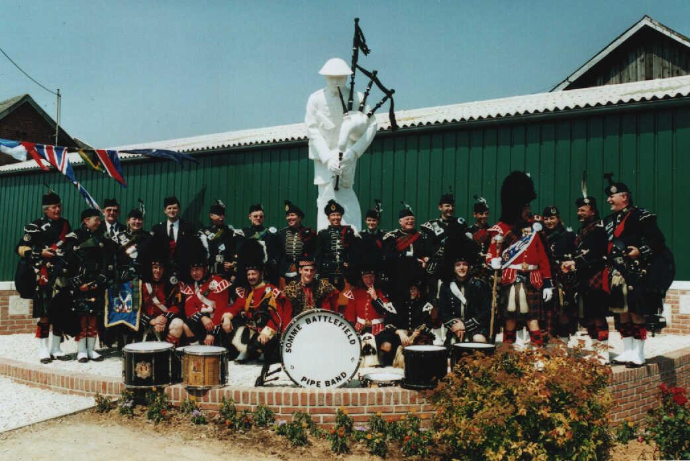


THE PIPERS MEMORIAL
20th ANNIVERSARY
2002 / 2022
LONGUEVAL
16/07/2022

Slide 2
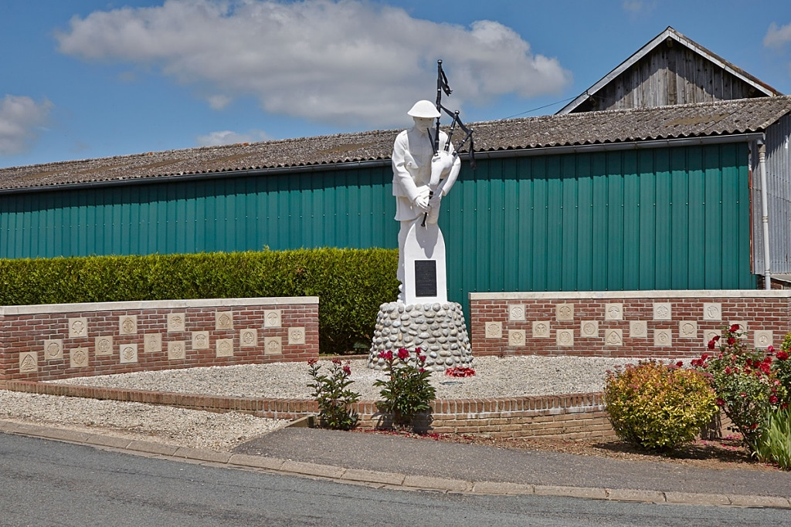
The Pipers Memorial in Longueval was unveiled on the 20th of July 2002. When more than 120 Pipers and Drummers came to the unveiling and Dedication Ceremony, coming from as far afield as Scotland, Ireland ,England, France ,Belgium, Holland, aso… In July 2022 we will gather once again on the 20th Anniversary of the Memorial to pay Tribute and Remember these Pipers of the Great War. .
YOU ARE INVITED TO REMEMBER THE PIPERS KILLED DURING THE GREAT WAR

Slide 3
TIMING
8.30 to 9.30 Arrival of the pipebands , individual Pipers & drummers , Reenactors, Standard Berarers, aso….
9.40 to 10.00 Pipers are tuning up
10.00 to 10.30 Mass Band Rehearsal at the SA Museum Cars Parking
10.50 Mass Band takes positon on at the starting Point (CHURCH)
First rows are prioritary for pipe bands pipers , followed by individual pipers and drummers
***************
11.00 to 11.20 Parade from tthe Church to the Square (main crossroad)
11.25 to 11.40 TUNES OF GLORY 1st Part
12.00 to 12.40 REMEMBRANCE CEREMONY
12.45 to 13.30 TUNES OF GLORY 2nd Part

Slide 4

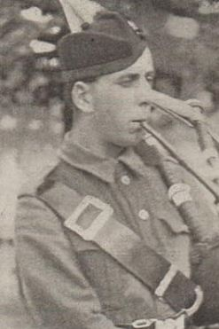
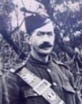
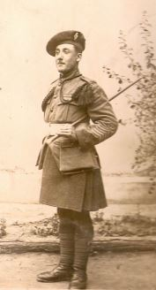
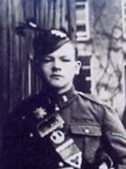
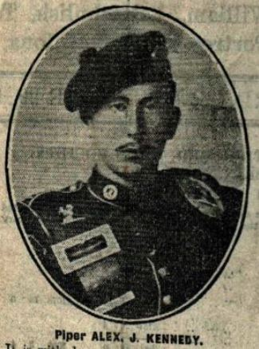

Slide 5
If you’re interested to take part, please complete & sign the form here below and send it at: sbpb@orange.fr before 15/02/ 2022 . After that date no more registration . Will be accepted
NAME (Nom) : ___________________________________________________
FIRST NAME (Prénom) : ____________________________________________
ADDRESS :_________________________________________________________
PAYS (Country)
Email:
TEL :
Coming as PIPER - DRUMMER - STANDARD BEARER - REENACTOR WW1
CORNEMUSEUX - TAMBOUR - PORTE DRAPEAU – RECONSITUTEUR 14/18
*********************
PIPEBAND ‘S NAME: ______________________________________________________________________
LOCATION :
COUNTRY :
TEL:
Email :
Number of Musicians : ____ PIPERS _____DRUMMERS __________DRUM MAJOR
___ BUGLER

Slide 6
CONDITIONS
All Participants must be correctly dressed, Military or Pipe Band Uniform preferred or the appropriate civil dress will be acceptable.
Everyone must know the Order of Parade, Ceremony and Concert.
All Participants must be fully insured by their own Insurance Provider, as the Organisers can not be held responsible for any subsequent loss or damage incurred at this event.
No fees can be paid for taking part in the Pipers Memorial Event.
Refreshments will be offered to all musicians after the end of the Ceremony. .
All musicians must be ready for the Practice at the correct time and follow the instructions, everyone must know all of the tunes being performed during the day.

Slide 7
PARADE , CEREMONY & CONCERT
SPEECH : by the Main Officer oand Piper’s Memorial Association’s Chairman.
CEREMONY : THE LAST POST + 2 min silence + THE ROUSE + THE FLOWERS OF THE FOREST (Lone Piper) + Wreaths laying
Bugler & Lone Piper leave the Memorial and join the Massband performing « The Battle of the Somme » (9/8)
4/4 51ST HIGHLAND DIVISION + 2/4 42ND ROYAL HIGHLANDERS
Slow Air : AMAZING GRACE (Lone Piper plays in solo the tune then mass band twice.
Slow Air 6/8 LONGUEVAL
Retreat March 3/4 THE PIPER OF LONGUEVAL
4/4 IT’S A LONG WAY TO TIPERARRY + PACK UP YOUR TROUBLES IN YOUR OLD KIT BAG + KEEP THE HOME FIRE BURNING Slow Air : HIGHLAND CATHEDRAL (Lone piper plays the 8 first bars then 2nd part by the mass ban + full air 2nd time) 4/4 AULD LANG SYNE + NAE AWA TAE BIDE AWA
END OF CONCERT
PARADE ORDER : MASSBAND + + WW1 REENACTORS + STANDARD BEARERS + VIPS + PUBLIC
LIST OF TUNES
MASS BAND : PARADE FROM THE S CHURCH TO THE SQUARE
3/4 THE GREEN HILLS OF TYROL + WHEN THE BATTLE IS OVER + LOCHANSIDE 6/8 92nd GORDON FAREWELL TO THE CREEKS + COCK O-THE NORTH 4/4 SCOTLAND THE BRAVE + THE ROWAN TREE
2) THE TUNES OF GLORY (pipers have made a large circle on the square and drummers stay in formation
BUGLE CALL
Slow Airs MY HOME + MORAF OF DUNVEGAN
3/4 THE ROAD TO PASCHENDAELE + THE BLOODY FIELDS OF FLANDERS
Bugler and Lone Piper leave the mass band and take place at the Pipers Memorial

Slide 8
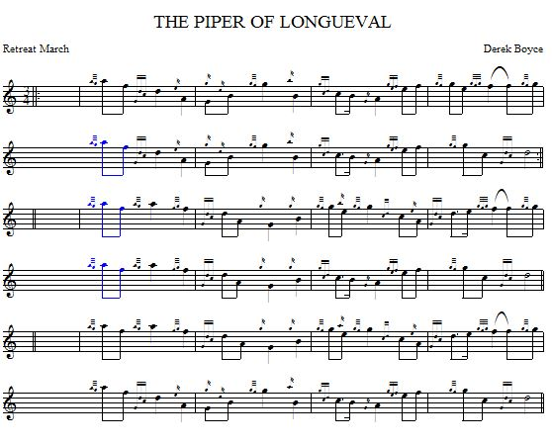
THE PIPER OF LONGUEVAL

Slide 9
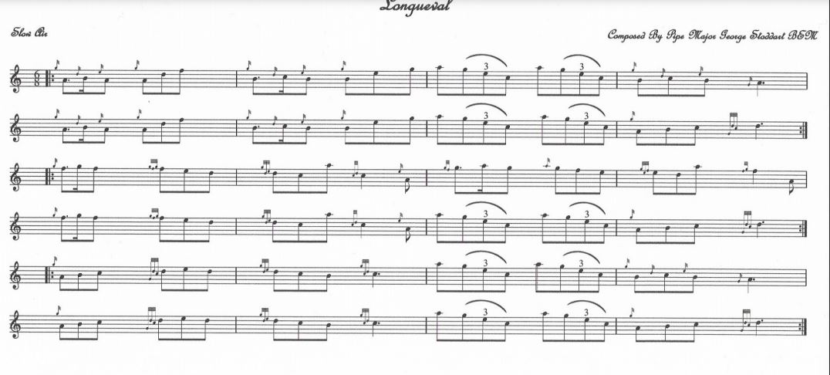

Slide 10
DRUMMING SCORES: Bass Drum, Tenor Drums and Snare Drums scores will be sent in a fee weeks

Slide 11
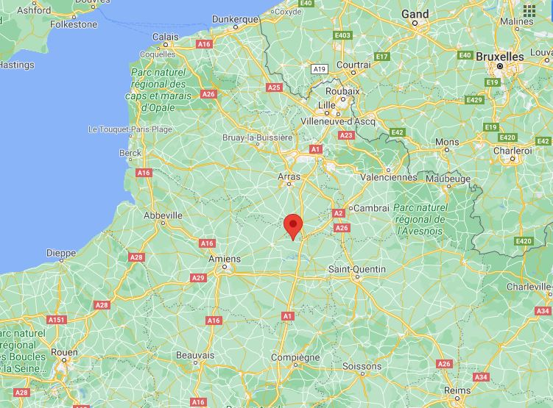
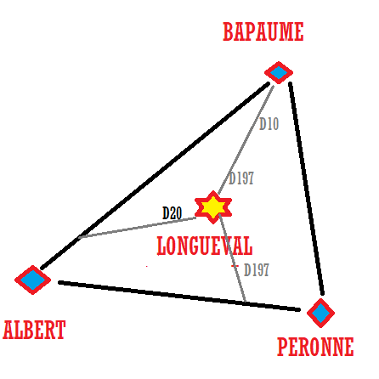
WHERE IS LONGUEVAL ?
Longueval is located in the Somme department, between Bapaume, Péronne and Albert.

Slide 12
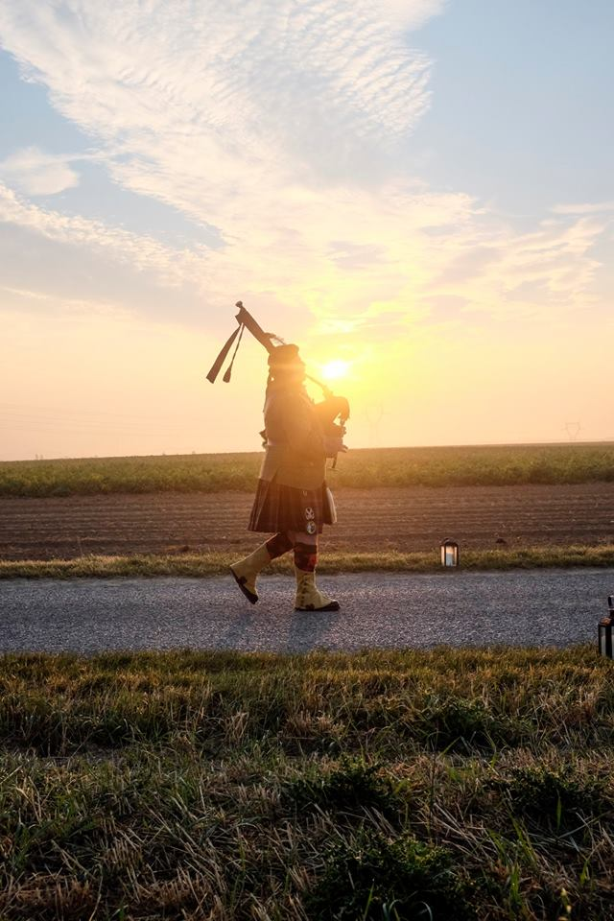
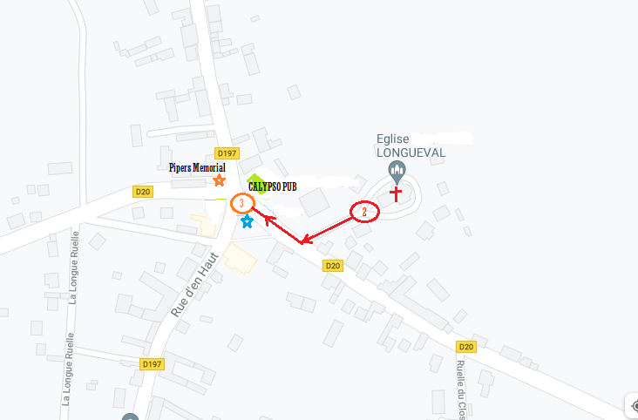
PARADE ITINARY
We will
remember them…

Slide 13
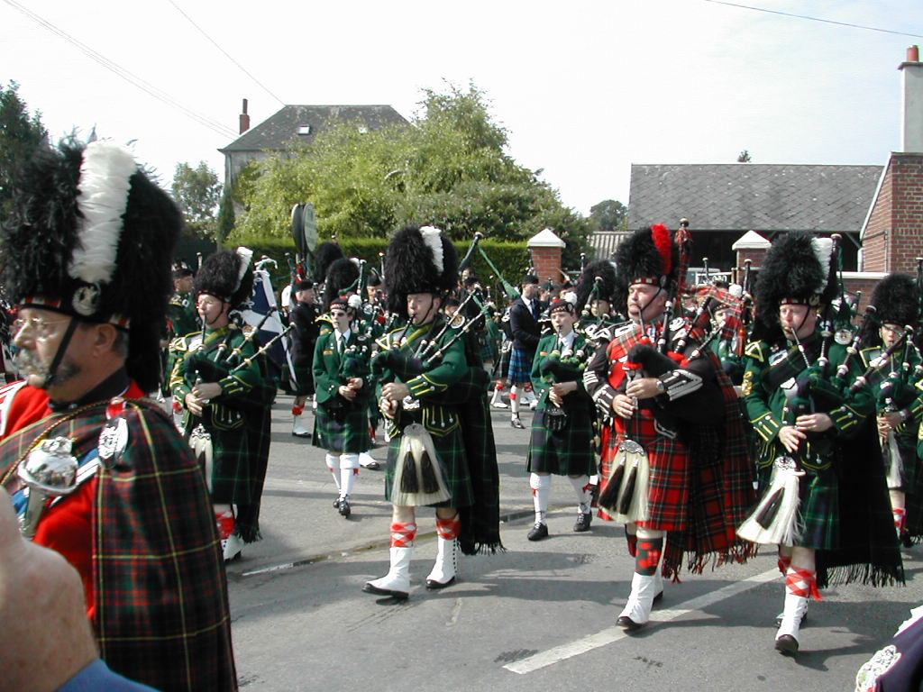
DATE OF REGISTRATION
The registration form must be sent before 15th February 2022 at: sbpb@orange.fr
The Organisers can be contacted by mail at: sbpb@orange.fr
Or by phone : 0033321485787
Organisers: Piper’s Memorial Association , Mairie of Longueval, Somme Battlefield Pipe Band.

Slide 14
More information
Special places will be reserved for coaches and other places for individual cars and minibus.
The roads around the center of the village will be securised and closed. During the time of the event
WC will be accessible
Some souvenirs for sale in the « Salle des Fêtes » to help the Piper’s Memorial Association
HOW CAN YOUHELP ?
Your coming is already a great part for the success of the 20th Anniversary , but you also can make a donation which will help for the different fees (cleaning and maintnance or repair of the Memorial, payment for security and first aid services , aso…)

Slide 15
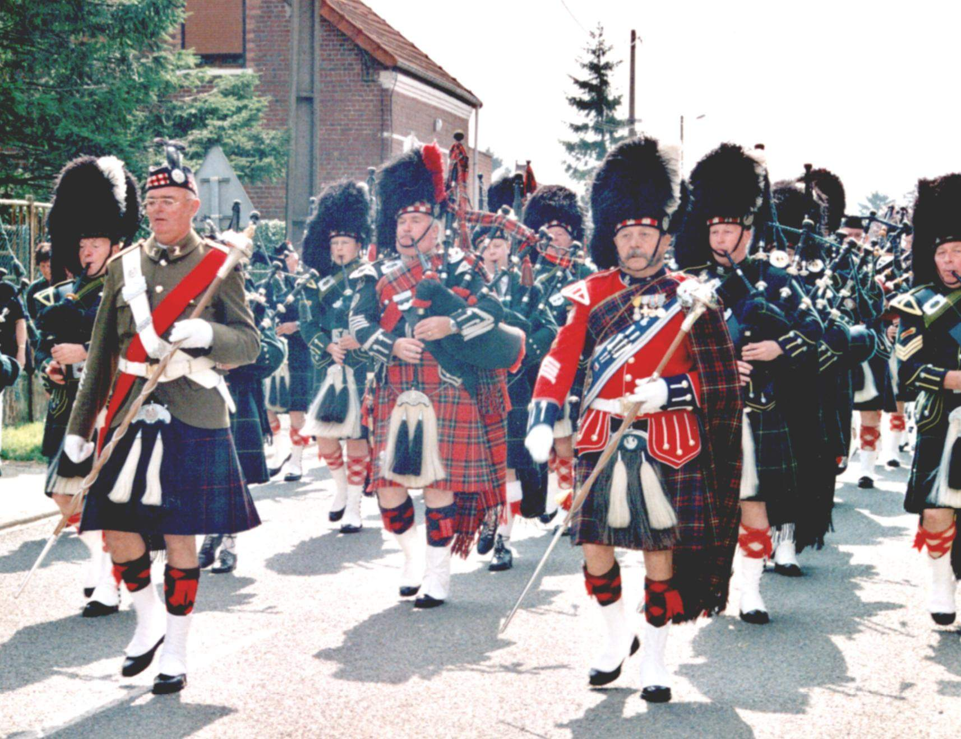
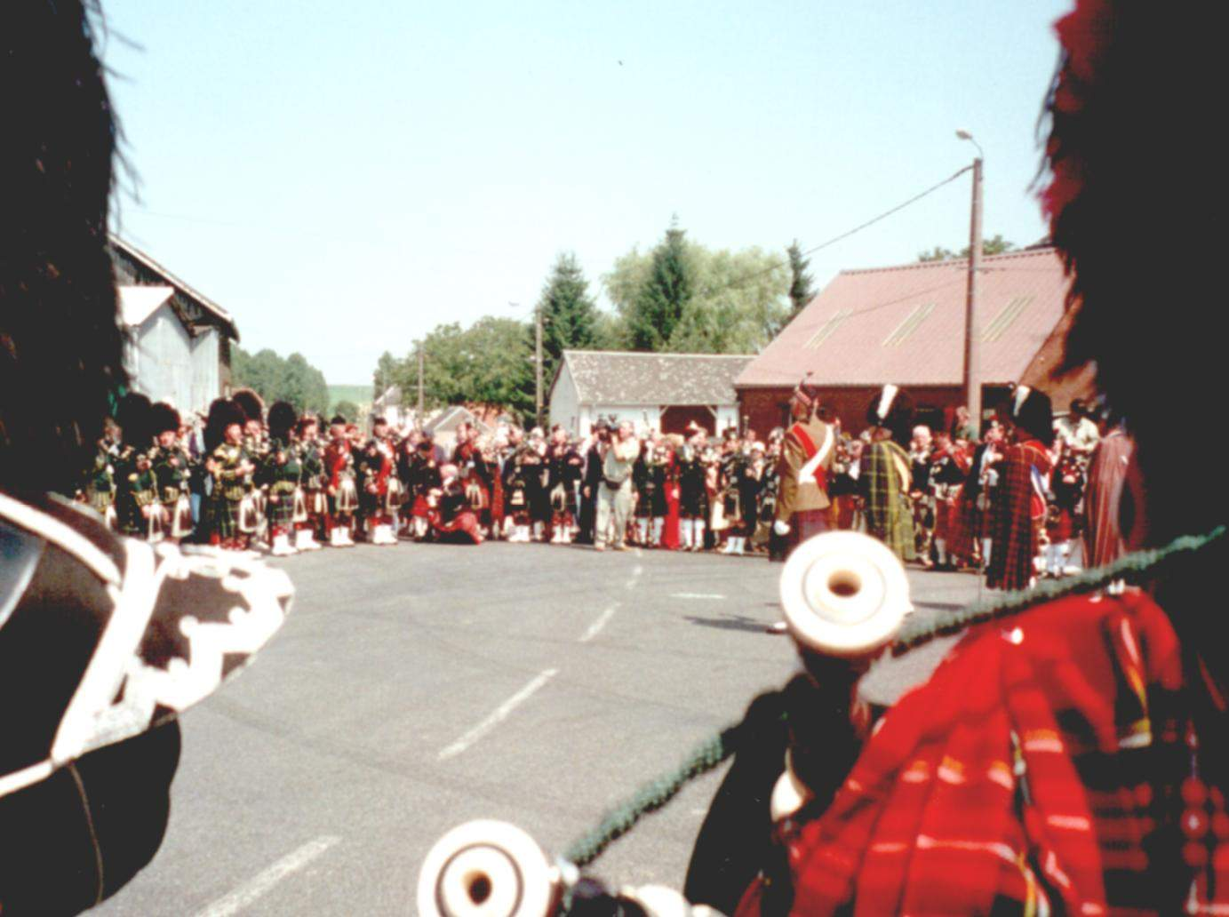
Souvenirs
Tunes of Glory
The parade

Slide 16
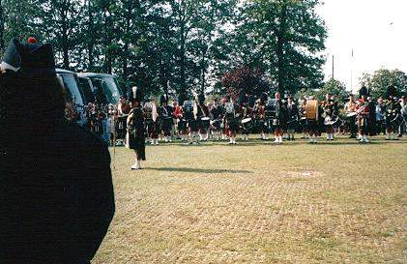
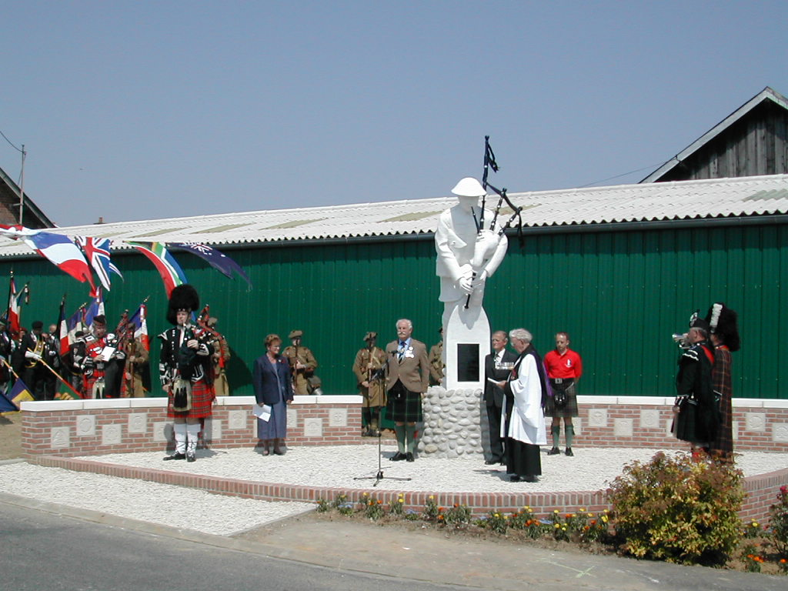
20 YEARS AGO…
The Last Post
Mass band rehearsal

Slide 17
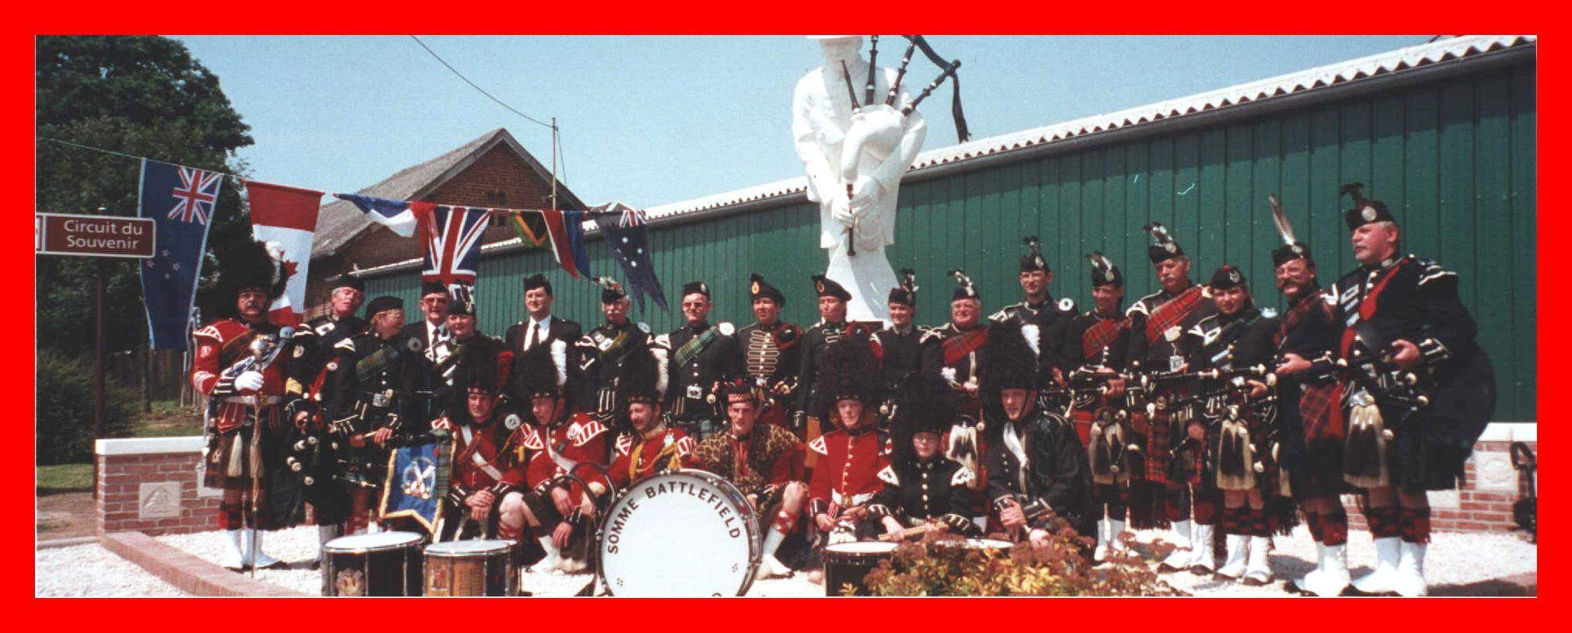
20 Years ago…
Somme Battlefield Pipe Band

Slide 18
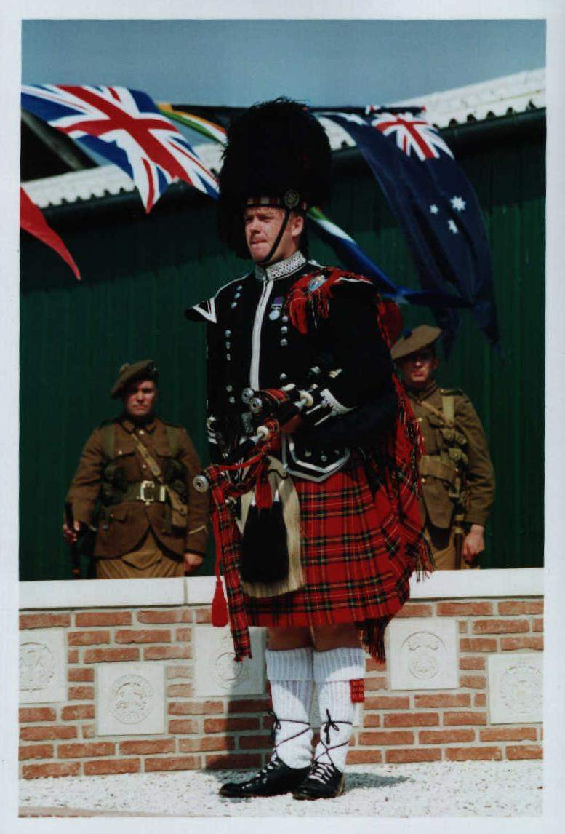


The Pipers Memorial Association
Committee Members
Honorary Chairman : Ian ALEXANDER (+)
Chairman : Ian ALEXANDER
Secretary: Douglas MENEY
Treasurer : Yves HOLBECQ
Members : Jeannie ALEXANDER, Jany FOURNIER, Andy DECOMYN, Albert CARTON , Malcolm HALLIDAY
IAN ALEXANDER Jr YVES HOLBECQ & IAN ALEXANDER

